Slide 1
Spotify playlist recommendation system
ADITYA AGARKHED
KABIR CHATURVEDI
VINAY SHIROLE

Slide 2

INTRODUCTION
Objective: To create a sophisticated music recommendation system
Process: Utilizing Spotify's rich dataset to predict user preferences
Goal : Leveraging techniques to predict user preferences and suggest songs they might enjoy

Slide 3

WHY THIS TOPIC

Slide 4
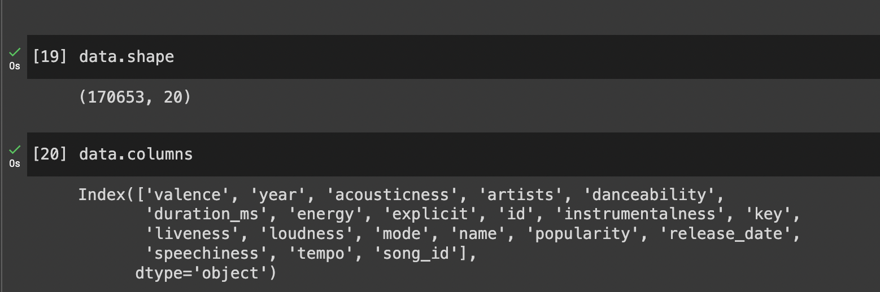
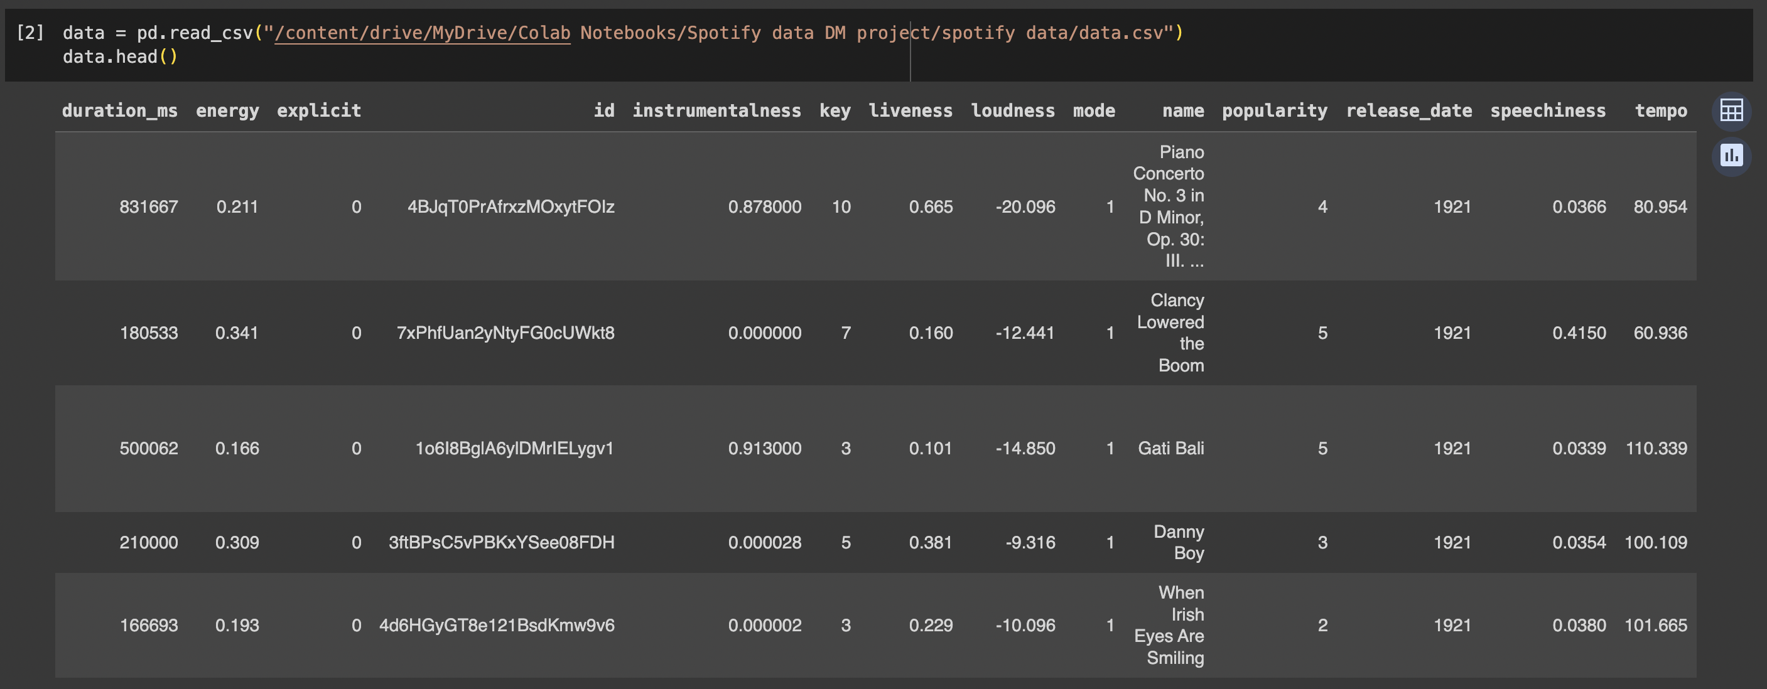
ABOUT THE DATA

Slide 5
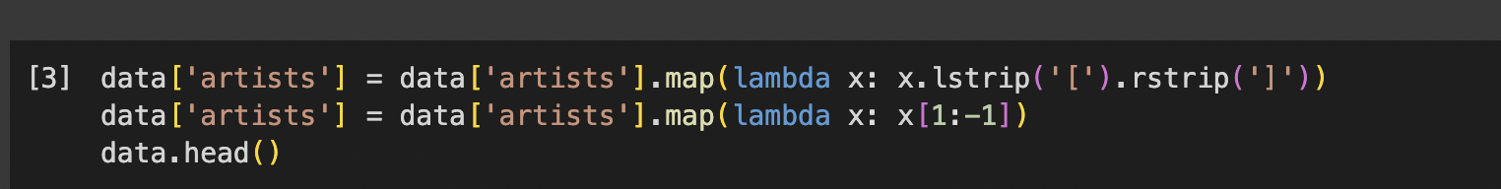
DATA PREPROCESSING
Used lambda function to remove brackets from ‘artists’ column
Got rid of NA values and calculated pearson coefficient

Slide 6
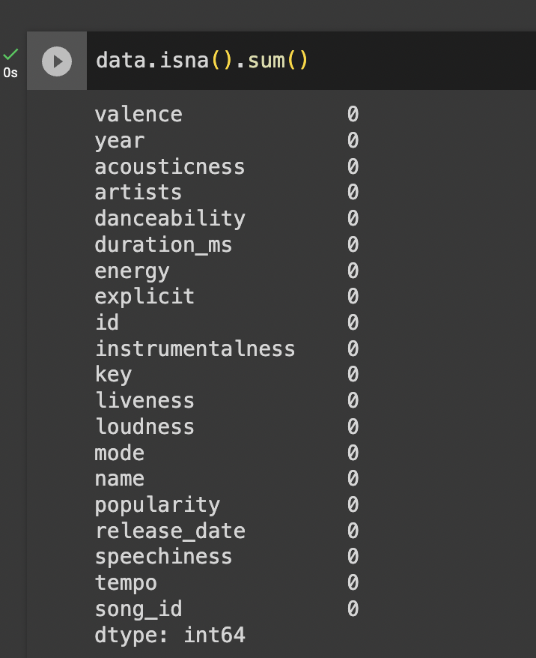
DATA CLEANING & PRE-PROCESSING
CHECKING FOR NULL VALUES

Slide 7

FEATURE ENGINEERING
PCA AND T-SNE USED
Why were they chosen?

Slide 8
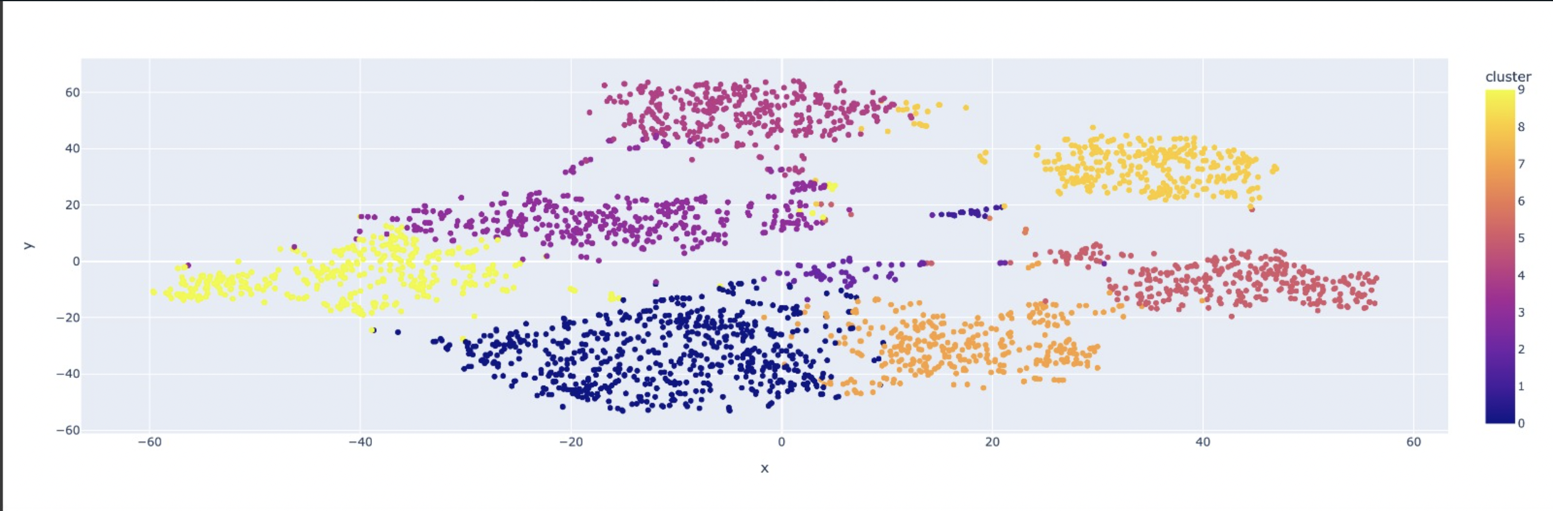
DATA VISUALIZATION:

Slide 9
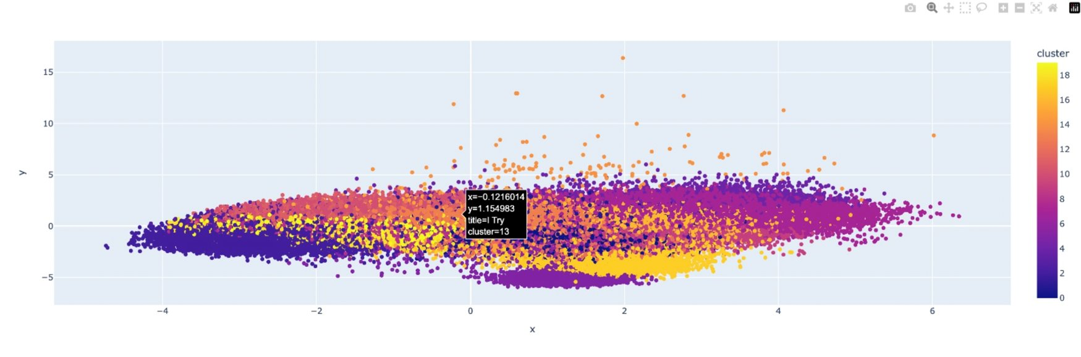

Slide 10
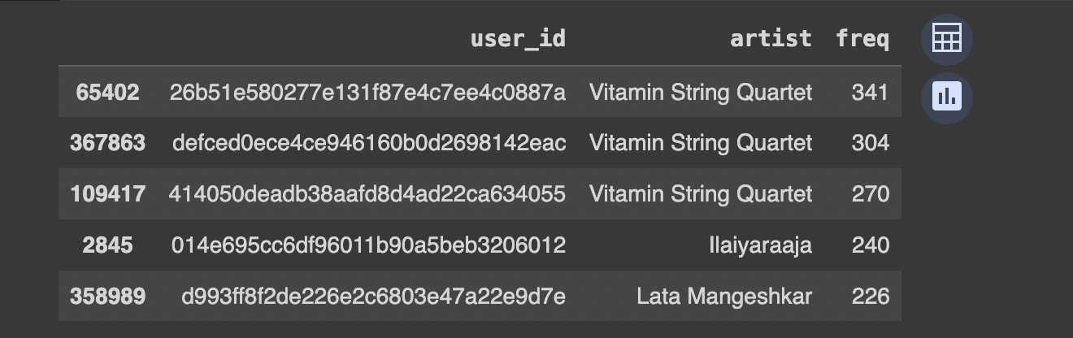
FILTERING THE DATA
Keeping only those artists who have appeared more than 50 times

Slide 11
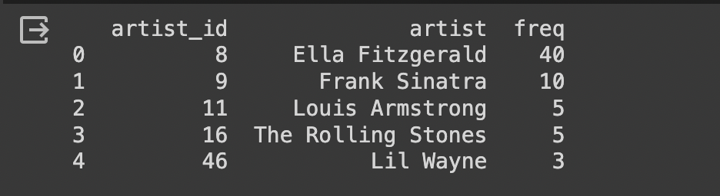
MAKING THE RECOMMENDATION SYSTEM
1) Data Preparation:
i) Convert user-provided artist data into a DataFrame.
ii) Associate artists with unique IDs and create inputArtist.
2) Recommendation System:
Implement user-based collaborative filtering.
Generate personalized artist recommendations based on user preferences.

Slide 12

MODEL BUILDING
Two main types:
Content Based Filtering
Collaborative Filtering

Slide 13
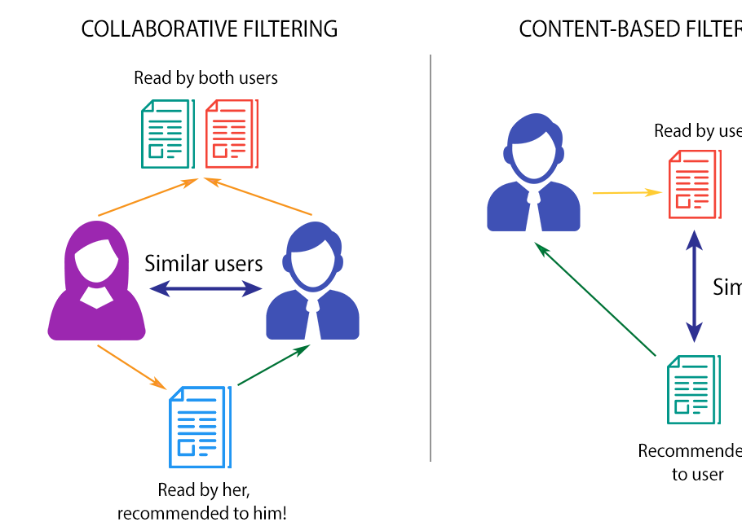
Brief explaination

Slide 14
CREATING FINAL FUNCTION:
Built a function to suggest similar songs based on selected distance methods.
Inputs: song_id and N, Outputs: Top N song recommendations with names.
Then we call on the function and store the recommended song names in the variable ‘SongName’.

Slide 15
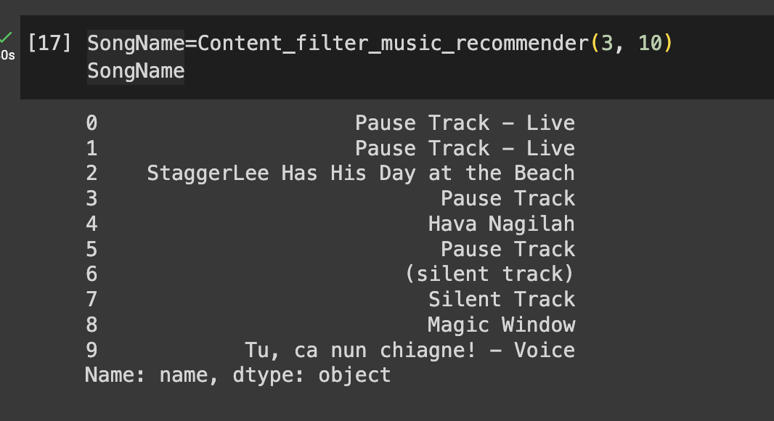
MAKING FINAL PREDICTIONS

Slide 16
Questions?

